Slide 1
OSINT
Beware. Your data is out there

Slide 2
OSINT – Open-source intelligence Digital Footprint
Open-source intelligence (OSINT) is the collection and analysis of data gathered from open sources (overt and publicly available sources) to produce actionable intelligence. (Wikipedia)
Digital Footprint
Privacy vs Publicaly available information

Slide 3

Disclaimer
Live presentation. Not a controlled environment and some contents may contain
Some links, websites, software or other items listed may or may not be legal, illegal, a felony, misdemeanor, or worse, in your country.
Please make sure that you are allowed to browse the websites, download links and software BEFORE USING!
I accept no responsibility in any kind for the use, misuse, downloading, viewing in whatever way the links in this presentation.
Please comply with company’s policies and do not use corporate resources for personal use.
Illegal activities may get you arrested. Check always what is legal.

Slide 4
Laws
Diário República Eletrónico (link)
ANACOM (link)
CNCS – Centro Nacional de Cibersegurança
Notificação de Incidentes
CERT.PT (link)
Unidade Nacional de Combate ao Cibercrime e à Criminalidade Tecnológica (UNC3T) (link)
Ministério Público (link)

Slide 5
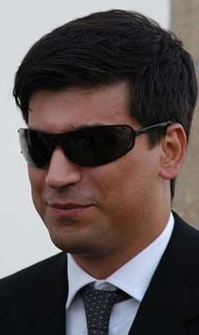
Who Am I
Pedro António Oliveira Vieira
Google (link)
YouTube (link)
LinkedIn (link)
Certified Ethical Hacker (link)
This presentation is not employee related
Notes:
Positive/False Results
Google
Positive/
Youtube
Account PAOV1976
Subscriptions (Interests, Friends)
Subscribers (Friends ?)
Linkedin
Location
Studied
Interests
“Friends”

Slide 6
Search Engines Internet is more than Google
Search yourself and check the results
Google (link)
Bing (link)
Yahoo (link)
Ask (link)
DuckDuckGo (link)
Baidu (China) (link)
Yandex (Russia) (link)
Different search engine → different rules/crawlers → different results
Notes:
Google - https://www.google.com/search?q=%22Pedro+Ant%C3%B3nio+Oliveira+Vieira%22
Bing - https://www.bing.com/search?q="Pedro+António+Oliveira+Vieira"
Yahoo - https://search.yahoo.com/search?p=%22Pedro+Ant%C3%B3nio+Oliveira+Vieira%22
Ask - https://www.ask.com/
DuckDuckGo - https://duckduckgo.com/
Baidu (China) - https://www.baidu.com/
Yandex (Russia) - https://yandex.com/

Slide 7
Google Dorks Commonly used searches
Google Advanced Search (link)
Google Hacking Database (link)
gbhackers (link)
google-dork-list (link)
Google Guide (link)
Google Guide (link)

Slide 8
Search operators Improve the search
filetype: search your results based on the file extension
cache: This operator allows you to view cached version of the web page.
allinurl: This operator restricts results to pages containing all the query terms specified in the URL.
inurl: This operator restricts the results to pages containing the word specified in the URL
allintitle: This operator restricts results to pages containing all the query terms specified in the title.
link: This operator searches websites or pages that contain links to the specified website or page.
info: This operator finds information for the specified web page.
location: This operator finds information for a specific location.
42 Advanced Operators (link)

Slide 9
Search Dork Examples
Google Search (link)
recibo vencimento -brasil filetype:pdf inurl:wp-content
recibo - keyword to look for
vencimento - keyword to look for
-brasil – keyword to ignore
filetype:pdf - only pdf files
inurl:wp-content – only inside wordpress sites
Available information on receipts
Full name, address, nif, nib, marital status, children number, ...

Slide 10
Search Dork Examples
Google Search (link)
“hacked by” site:pt
“hacked by” - keyword to look for
site:pt - only “portuguese” sites (registered portuguese domains)
About 5350 results
Sites / pages that were “tagged”/”signed”
Attack and contents changed to show off skills (mainly kids) – compared to street tagging

Slide 11
Passwords / Credentials Please don’t share
Kaspersky
Check your password (link) (or maybe not)
Check last name – “vieira” or “Vieira” or “Vieira123”
Top 10 passwords
“qwerty”, “password”, …
Country specific: BR example “password” → “senha”
Daniel Miessler SecLists
Usernames (link)
Passwords (link)
Default Credentials (link)

Slide 12
Databreach Is not a thing of the past
Troy Hunt
HaveIBeenPwned (link)
Pwned websites (link)
Ashley Madison Breach 2015 (link)
When private data gets public
Piracy - Subtitles
Don’t think you can hide – Illegal activities are tracked
Companies are leaking all your information
Compromised data: Dates of birth, Email addresses, Employers, Family structure, Genders, Income levels, Living costs, Marital statuses, Mothers maiden names, Names, Phone numbers, Physical addresses, Places of birth, Religions, Spouses names

Slide 13
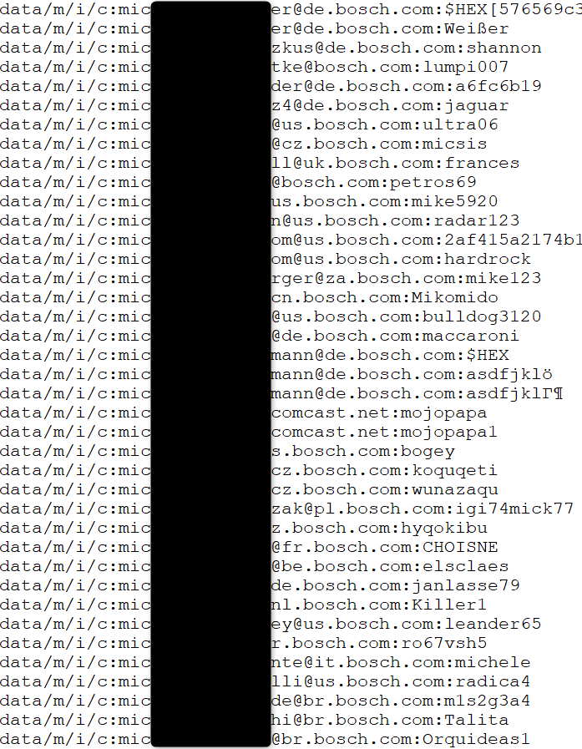
Databreach Company credentials ?
Email/Login
Password
Source
Publicly available list of credentials
More than 10k credentials just for Bosch
Information gathered
Rule of email/login
(FirstName.LastName)@(Country).(company).com
Rule of password complexity
List of users
Phishing campaigns
Brute force
Look for those users on Social Media
Added Problem
Credentials reuse

Slide 14
Databreach Portuguese domain examples (2018)
uminho.pt - Universidade do Minho
adv.oa.pt - Ordem dos Advogados
pj.pt - Policia Judiciária
mail.exercito.pt - Exército
cm-braga.pt - Câmara Municipal de Braga
cm-guimaraes.pt - Câmara Municipal de Guimarães
psd.pt - Partido Social Democrata
ps.pt - Partido Socialista
fcporto.pt - Futebol Clube do Porto
min.justiça - Ministério da Justiça
Were these the sources for criminal “hacker” Rui Pinto ?

Slide 15
OSINT OSINT Framework
https://osintframework.com/

Slide 16
OSINT Profiling
What’s my IP? (link)
Ip2Location (link)
Mylocation (link)
VPN
ProtonVPN, …
Facebook
StalkFace (link)
Sowdust Github (link)
IntelligenceX Facebook Search (link)
Formulas for Searching Facebook (link)

Slide 17
OSINT Profiling
Mobile (how long have you been using the same number)
Sync me (link)
Usernames (you reuse usernames)
NameChk (link)
WhatsMyName (link)
NameCheckup (link)
Twitter
Twitter Advanced Search (link)
New tools are always being created

Slide 18
OSINT Profiling - Professional
LinkedIn (link)
Xing (link)
Company Information
Technologies described in job adds (leaking information)
Professional information phishing
Fake job adds (Is this a thing?)
Curriculum Vitae
Sending CV with too much information – what is too much ☺
Home address – Street View

Slide 19
OSINT (Reverse) Image search
One image is worth 1000 words, maybe more.
Google Images (link)
Bing Images (link)
Yahoo Images (link)
Tineye (link)
Yandex (link)
The professionals (link)

Slide 20
OSINT Maps
Google Maps (link)
Bing Maps (link)
Wikimapia (link)
Tips, Tricks and Techniques (link)

Slide 21
OSINT Street View
Google Street View (link)
Identify house by address
Assess security (cameras, fences, ...)
Parked cars (timeline, ...)
People’s habits/routines, timetables, ...
View the past – timeline (link)
Instant Street View (link)

Slide 22
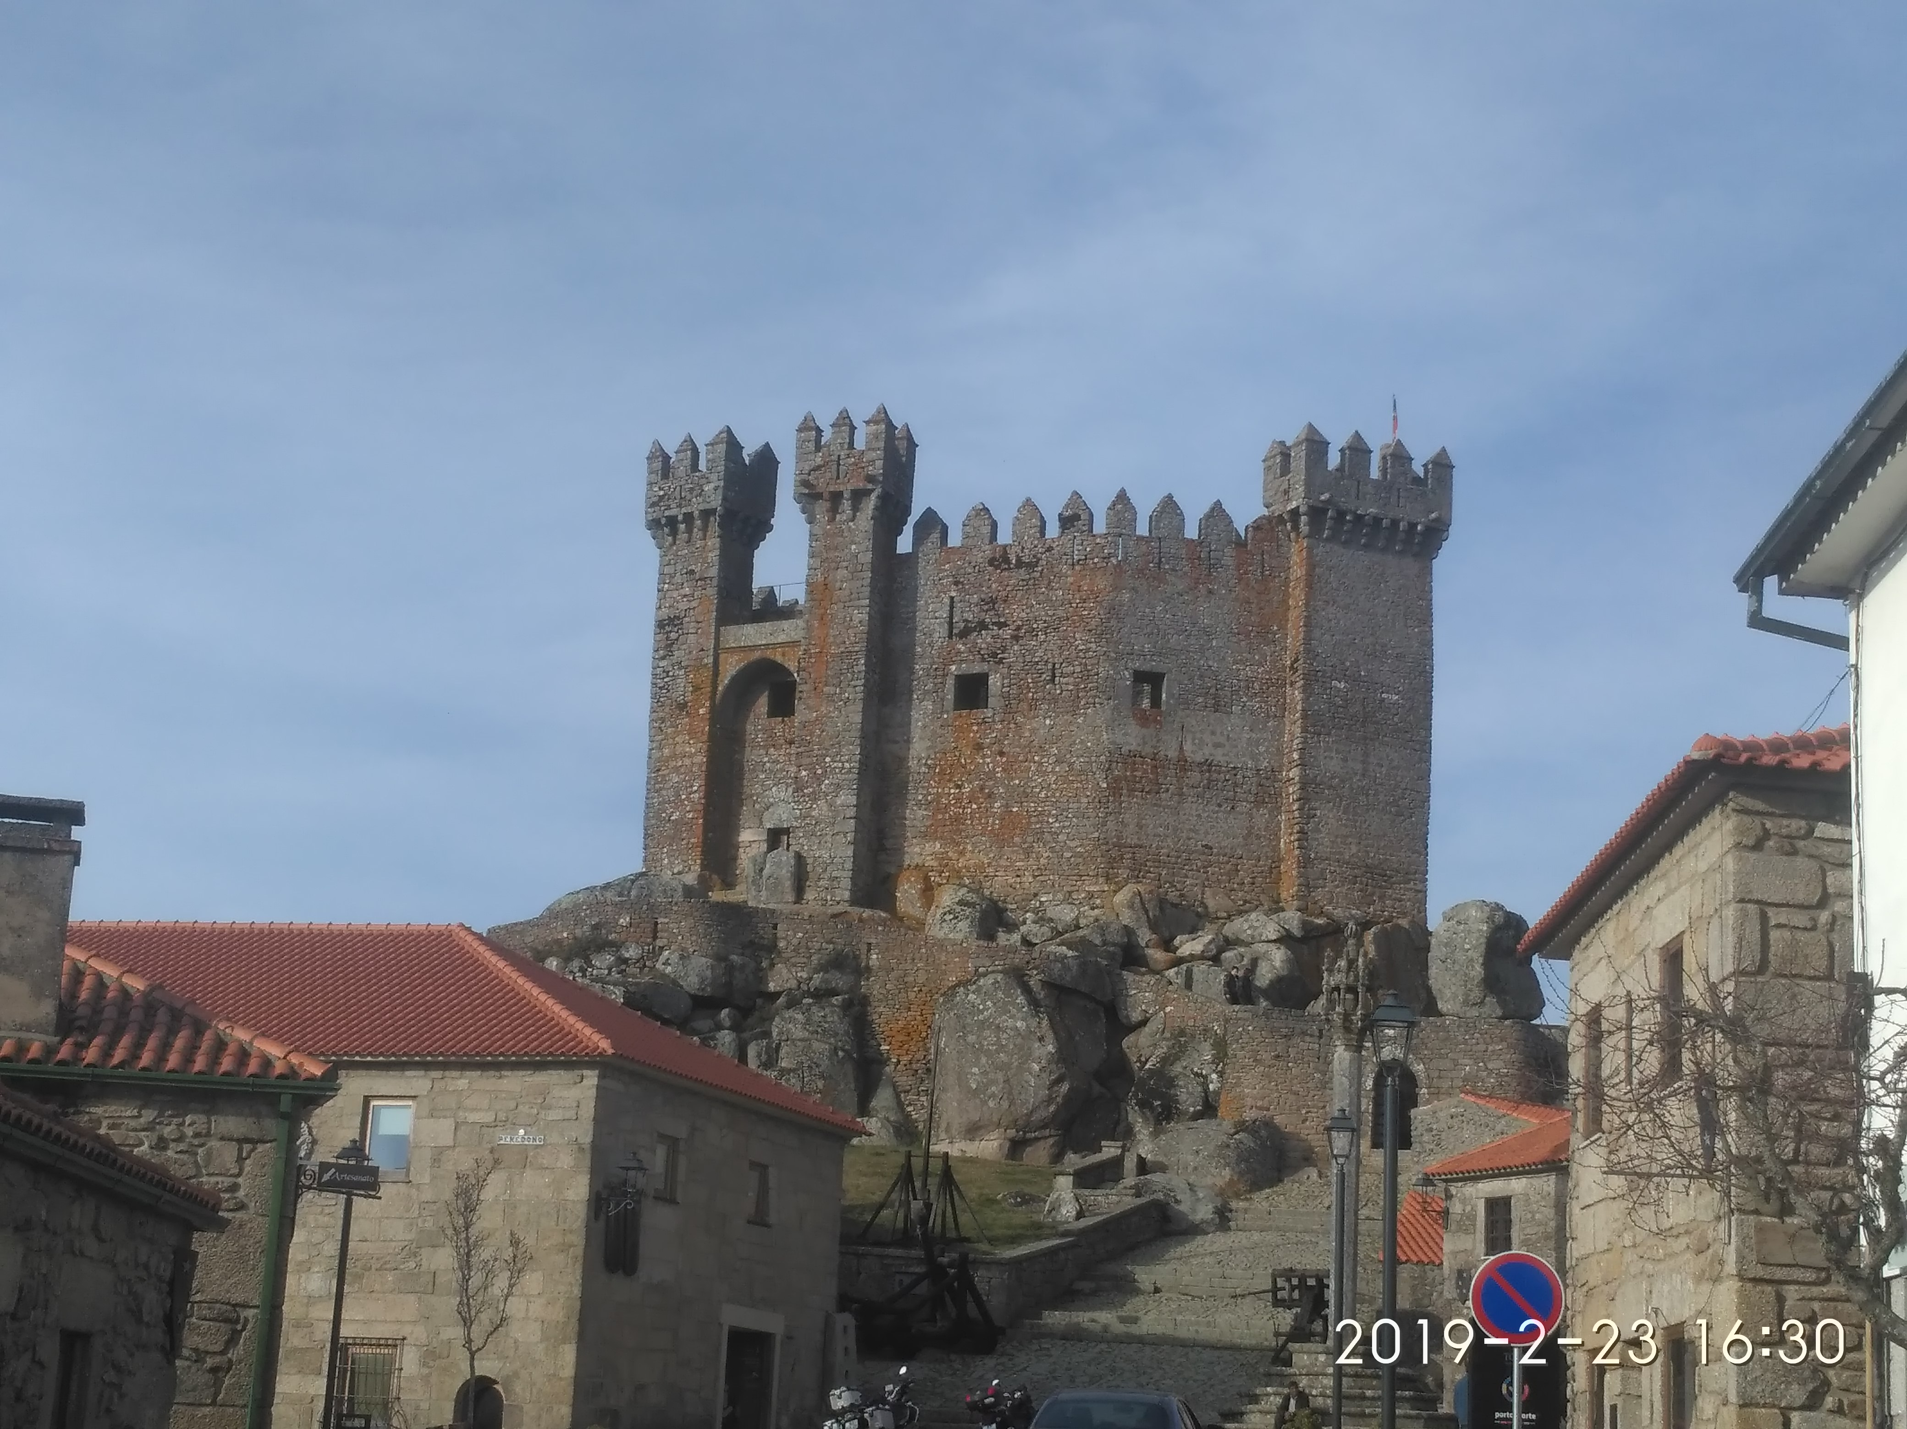
OSINT - Photos Lots of Information
Where was this image taken?
Have you been there?
When?
Date stamp on photo
Filename with date
Metadata
What else?
Image search

Slide 23
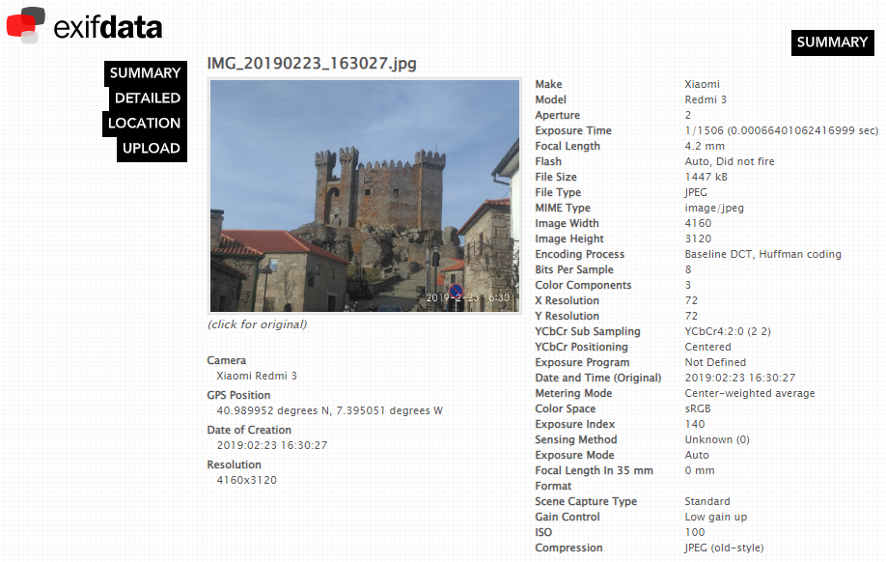
OSINT - Photos Metadata
Metadata
GPS (link)

Slide 24
Search Geolocation
Digital Cameras/Mobile Phones
Metadata
Geolocation
Camera Model
…
Breasts lead to arrest of Anonymous hacker (link)
Police allege that an Anonymous hacker posted a picture of his presumed girlfriend's breasts as a taunt to U.S authorities. The picture allegedly contained GPS information that led the FBI to her.

Slide 25
Search Satelite View
Zoom Earth (link)
Satelites Pro (link)
World Imagery (link)
Wayback (link)
Wayback example (link)
View the past - timeline

Slide 26
Helping Tools Safety
VirusTotal
Check received files (link) (don’t upload Personal or company related information)
Netcraft
Sitereport (link)
Credit Card Shopping
Virtual Card
Mbnet
Revolut
PayPal

Slide 27
Helping Tools Privacy
Temporary Email
10 minute email (link)
20 minute email (link)
Disposable Email
60 minute email (link)
Internet Access (DarkWeb included)
Tor (link)
Tails (link)

Slide 28
Helping Tools Reverse Tracking
Gmail Plus Address
So what is a Gmail Plus address? Say you have an email address like billgates@gmail.com. If you append a “plus” sign to your email username, Gmail will ignore anything written between the + and @ sign in the email address and still deliver the message to the same mailbox.
So any email address sent to billgates+microsoft@gmail.com or billgates+blog@gmail.com or billgates+website@gmail.com will still reach the Gmail inbox of billgates@gmail.com inbox though, technically, they are three different email aliases.
https://www.labnol.org/internet/email/gmail-email-alias-two-separate-gmail-address/2388/

Slide 29
Deadly Social Media The Final Hours of Pop Smoke
Rapper Pop Smoke Murdered in Home Invasion ... By 4 Masked Gunmen (link)
Instagram Posts
Location Tag
Geolocation
Reverse Image
Google Maps
Local Recon
Airbnb/Zillow (Rent/Real-estate)
House photos (Outside and Inside)
Layout
YouTube Video: The Cyber Mentor (link)

Slide 30
OSINT Personal Information
Posted information can get publicly and world available
Even private profiles can have their data shared by others
When information is posted
Shows where you are at that time (habits & routines)
Information on the picture
Metadata
Geolocation
Awareness.
What do we teach our kids? Do we teach ?
They are exposed to everyone on the internet.

Slide 31
Awareness True stories
Someone posted a photo of healthy meal
Laptop in background: Zoomed in and read emails
Social Media uses OCR. They also read the emails
I once posted picture on social media while on trip
My friends knew I was not home (Not public profile. At least I think it is not)
Friends on that location called me on the phone
Buying book (Buyer’s card information)
How I was able to get money just by having the right information
Social Media accounts
If you don’t have Facebook, I can create one in your name and call your friends

Slide 32
OSINT Portugal – Public contracts
Base (link)
Example (link)
PDF of contract with PII strikethrough (link)
Open with pdf reader and delete the strikethrough boxes
Name of employee who edited the document
Information on UA, LinkedIn, Facebook, …
Metadata: “KONICA MINOLTA bizhub C454”
Information leaked
Full Names, nif, addresses

Slide 33
OSINT Portugal – Vehicle Information
Automóvel On-line (link)
Certidão Permanente Automóvel (link)
License Plate : “01-EF-34”
Result
Brand: MERCEDES-BENZ
VIN: WDD2040081A043326
Example (link)
Vehicle Information (link)
Example (link)
Information: Brand, Model, Location, Paint, Delivery Date, Extras, …
Hack accross the globe by VIN (link)

Slide 34
OSINT Portugal –Insurance Information
ASF – Autoridade de Supervisão de Seguros e Fundos de Pensões (link)
Example (link)
License Plate : “01-EF-34”
Date : “03-07-2022”
Example 2 (link)
License Plate : “01-EF-34”
Date : “03-07-2012”
Insurance Company
Current and Past
Length of the contract
Insurance policy number

Slide 35
OSINT Portugal Specific
Registo Predial Online (link)
DGES - Direção-Geral de Ensino Superior (link)
DRE - Diário da República (link)
Search DRE (link)
Finnaças - Penhorados (link)
Example (link)
Search Penhorados – (link)
Ministério da Justiça - Penhorados (link)
Plataforma Eletrónica de Compras (Administração Pública) (link)
Leaked information:
Full Names, Addresses, NIF, Company, Marital Status, …

Slide 36
Wayback Machine Internet in the past
Wayback Machine (link)
Archive.is (link)
Cached Pages (link)
Cached View (link)
OldWeb.Today (link)
Time Travel (link)

Slide 37
Shodan Internet of Things
Search Engine for Internet Of Things
Explore
Shodan explore (link)
Images
Shodan images (link)
Maps
Shodan maps (link)
Internet Exposure Observatory
Exposure Dashboard (link)

Slide 38
Shodan Internet of Things
Remote Desktop (link)
Total results: 3,482,756
Braga (link)
Images
Braga (link)
VNC Remote Access and Loggedin (link)
Authentication Disabled
Portugal (link)
Primavera (link)
Contabilidade (link)

Slide 39
Shodan Internet of Things
Fotos
Portugal (link)
IP Cameras
Portugal (link) (default credentials?)
Webcams (link)

Slide 40
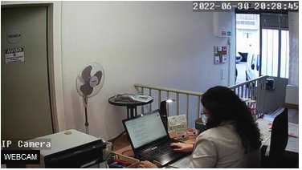
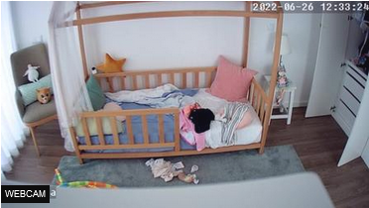
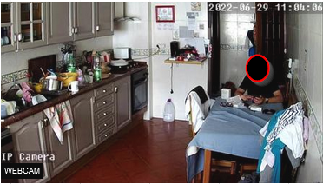
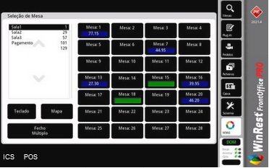
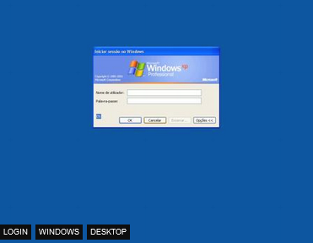
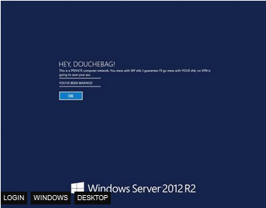
Shodan Internet of Things - Images

Slide 41
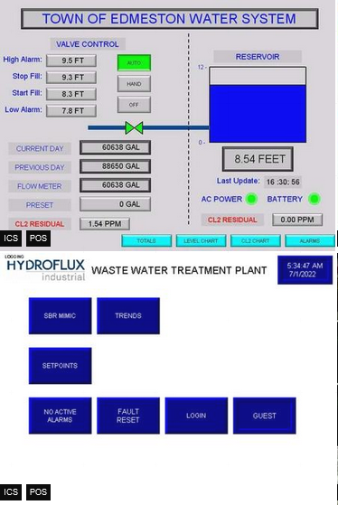
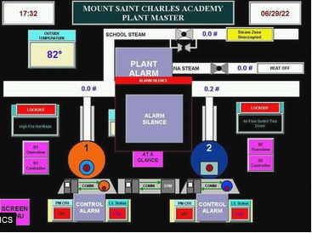
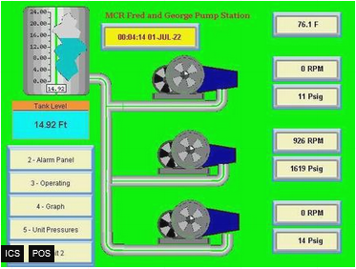
Shodan Industrial Control Systems
Industrial Control Systems (link)

Slide 42
Shodan Portugal – Internet Exposure
Internet Exposure Dashboard (link)
Top Vulnerability
CVE-2015-0204 – CVSS2 4.3 Medium (link)
BlueKeep Unpatched (link)
107 (link)
Industrial Control Systems
516
SMB (shared folders)
Authentication Disabled: 2898

Slide 43
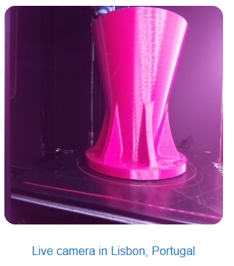
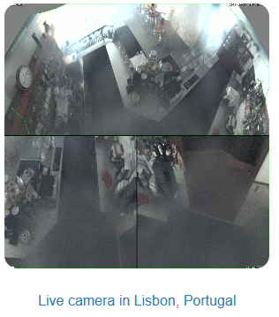
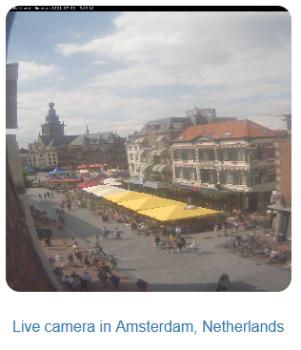
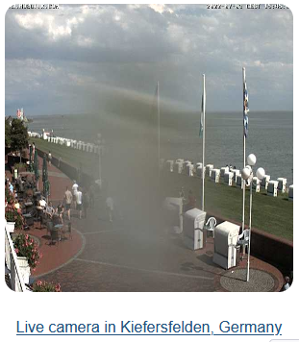
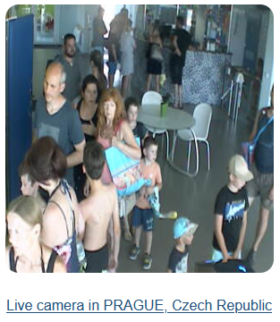
Insecure Insecure Cameras
Browser edit (link)
Portugal (link)

Slide 44
Penetration Test Portugal – Ministério da Justiça
How safe is our information?
Site URL: https://www.automovelonline.mj.pt/AutoOnlineProd/
Is there a DEV site?
Error shows software and version (Apache Tomcat/8.0.41)
Are there exploits? Exploit Database (link)
Automatic testing website (link)
Are these tests legal?
If you don’t own the site, it’s usually not legal or allowed.

Slide 45
CTF Capture The Flag
TryHackMe - https://tryhackme.com/
HackTheBox - https://www.hackthebox.eu/
VulnHub - https://www.vulnhub.com/
OTW - https://overthewire.org/wargames/
PicoCTF - https://picoctf.org/
CryptoPals - https://cryptopals.com/
CryptoHack - https://cryptohack.org/

Slide 46
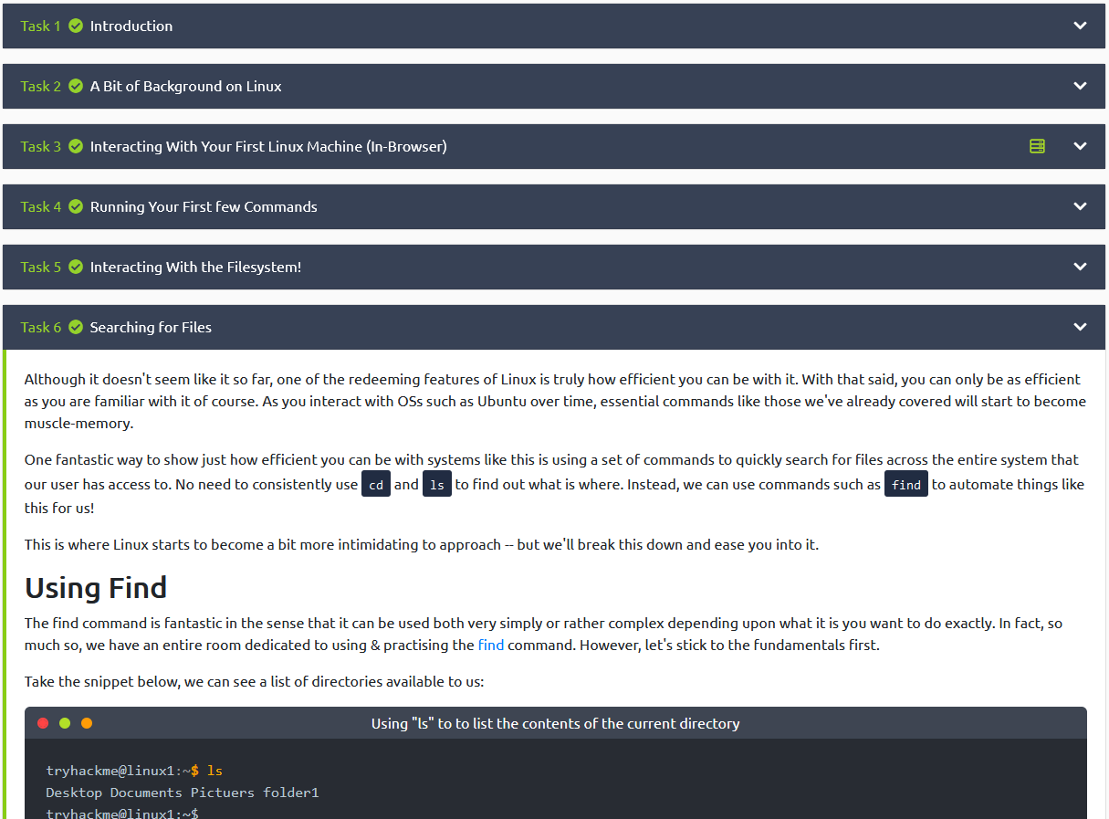
CTF THM – Try Hack Me
Try Hack Me (link)
TryHackMe is a free online platform for learning cyber security, using hands-on exercises and labs, all through your browser!
Learn
Our content is guided with interactive exercises based on real world scenarios, from hacking machines to investigating attacks, we've got you covered.
Practice
Put your knowledge into practice with gamified cyber security challenges.
Cost – Free or $10/month

Slide 47
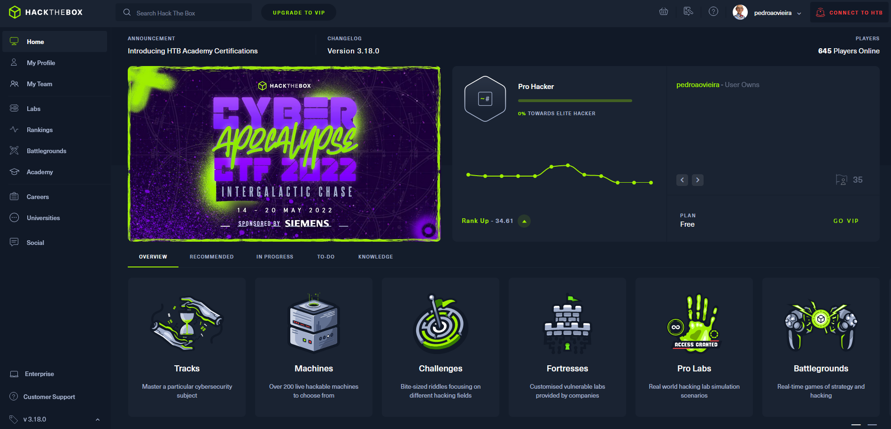
CTF HTB –Hack The Box
Hack The Box (link)
Hack The Box is a massive, online cybersecurity training platform, allowing individuals, companies, universities and all kinds of organizations around the world to level up their hacking skills.
Challenges
Hardware, Crypto, Pwn, Mobile, Reversing, Web, …
Machines / Tracks
Cost – Free / €12/month
Job Board

Slide 48
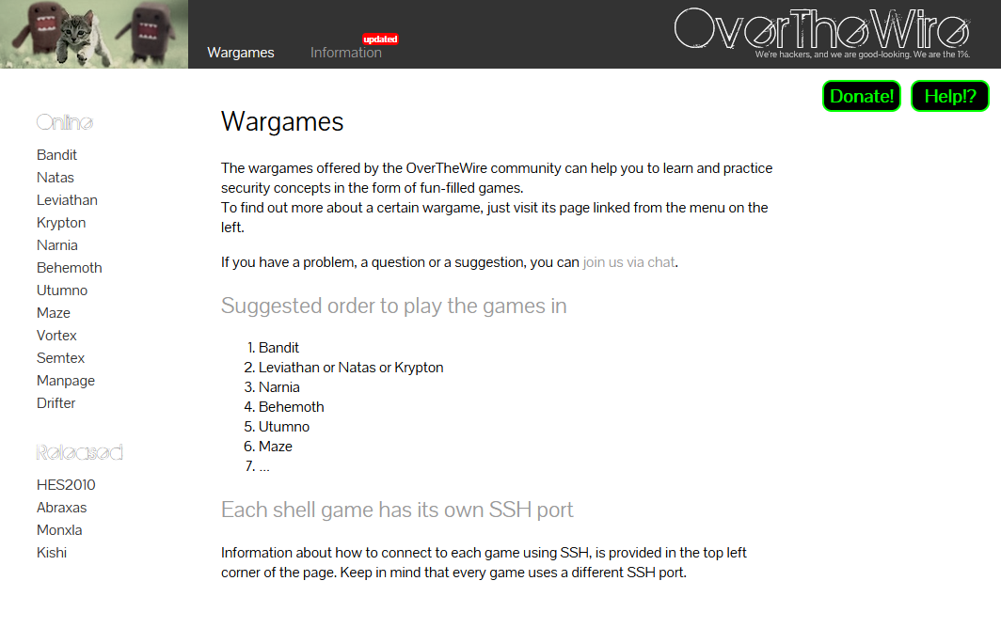
CTF OTW –Over The Wire
Over The Wire (link)
Linux and Web based games
Linux - Bandit
Web - Natas

Slide 49
Verificar
https://especiais.rr.pt/pegada-digital/pedi-os-meus-dados-a-70-empresas/

Slide 50
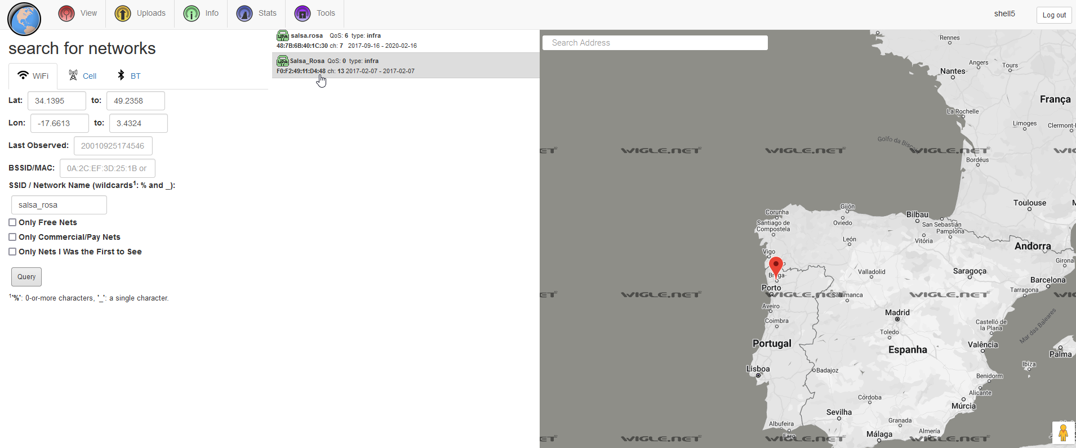
Wifi World Map - WiFi Networks
Wigle – shell5
https://wigle.net/map?maplat=41.53443897842117&maplon=-8.437174307569958&mapzoom=21&coloring=density
mac address lookup
https://dnschecker.org/mac-lookup.php?query=68-cc-6e-c0-c7-e1

Slide 51
License
Feel free to share/modify,…

